Slide 1
Forensic Toolkit Analysis
Casey Preston Brandon

Slide 2
Digital Forensics
Prevent Data Loss and Changes
Collect and Recover data
Analyze the data for evidence
Convert for court

Slide 3
Anti - Forensics
Reduce Quality and Quantity
Increase Time and Complexity
Slow them down
Throw them off
Go undetected

Slide 4
Overall team goal
Evaluate Anti-Forensic impact on Forensic Toolkits
Choose popular forensic toolkits
Research and implement common tactics
Perform evaluation
Generate Results

Slide 5
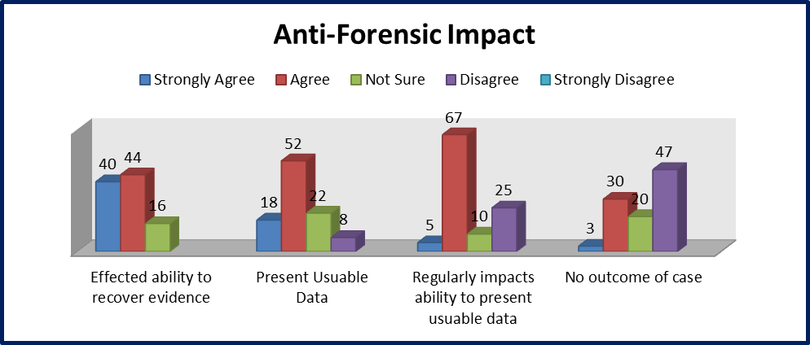
Beer, Richard. Anti-Forensic Tool Use and Their Impact on Digital Forensic Investigations: A South African Perspective. The Proceedings of the International Conference in Information Security and Digital Forensics, Thessaloniki, Greece, 2014.
Why should I care?

Slide 6
Research - Hidden
Alternate Data Streams
Steganography
Inject into carrier files
Slack Space
Used PEBrowse and HexEditor

Slide 7
Research - Destroyed
CCleaner - popular freeware cleaner
Sdelete - command line file deleter, from Microsoft
Eraser - 13 different methods, ones I used were US Air Force 5020, and Schneier seven pass

Slide 8
Research - Altered
Timestamp Manipulation
File Format Manipulation
Extensions
Signatures
Encryption
Plausible Deniability

Slide 9
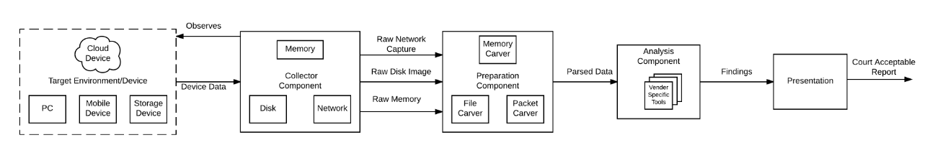
Component Diagram
Target
Prep
Present
Carve
Analyze

Slide 10
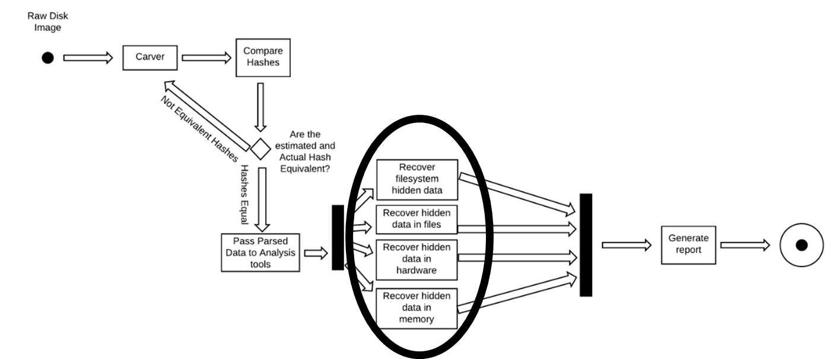
User Story - 1
As a Computer Forensic Analyst, I want to detect and recover hidden data so I can spot trails of evidence

Slide 11
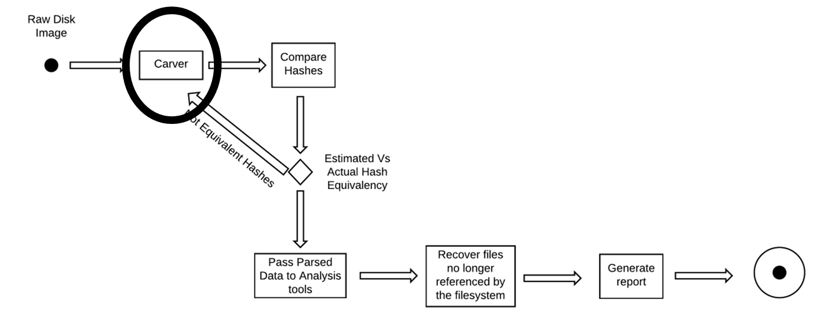
User Story - 2
As a Computer Forensic Analyst, I want to detect and recover deleted data so I can support/define a suspect's intent

Slide 12
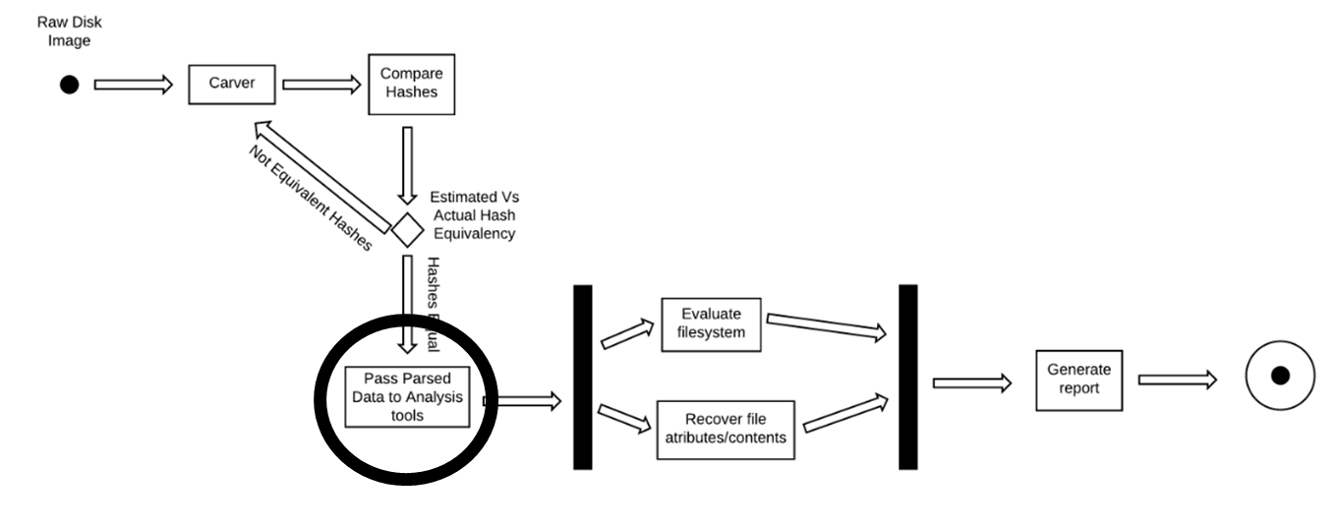
User Story - 3
As a Computer Forensic Analyst, I want to identify and understand system contents so I can develop an overview of user activity

Slide 13
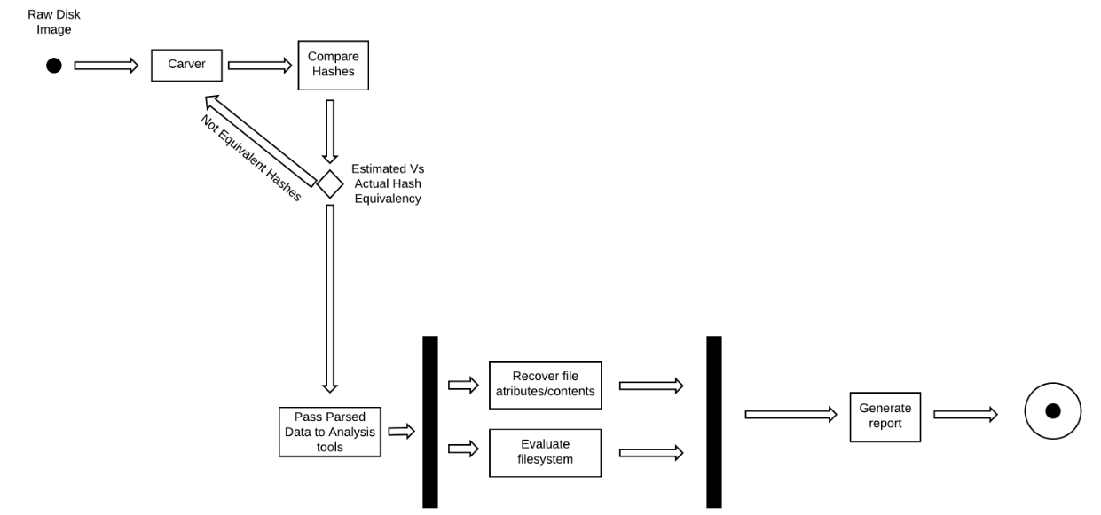
User Story - 4
As a Computer Forensic Analyst, I want to detect system modifications so I can construct a timeline of actions taken

Slide 14
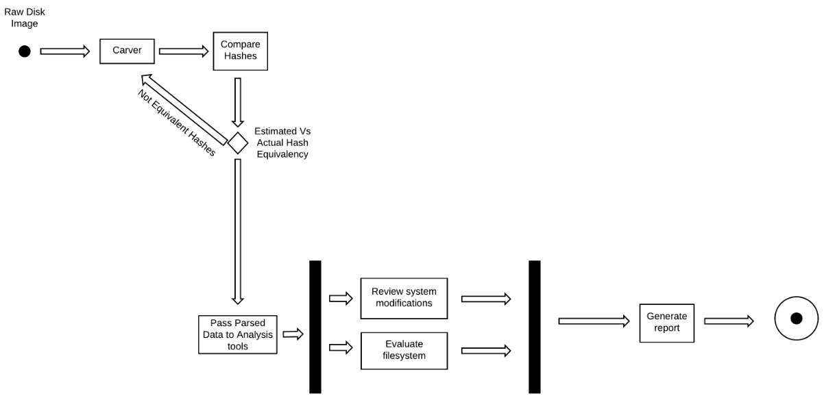
User Story - 5
As a Member of a Computer Incident Response Team, I want to view previous activity on a system so I can restore the system's availability

Slide 15

Demonstration:

Slide 16

Evaluation Scores
0
33%
67%
100%
No Understanding
Partial Understanding
Full Understanding

Slide 17
Toolkit Performance - Hidden
 | SIFT | DFF | CAINE
Steganography | 33% | 33% | 33%
Slack Space | 33% | 33% | 33%
Alternate Data Streams | 100% | 100% | 100%
Total: | 56% | 56% | 56%
- No support for Steganalysis - Strings in unallocated space

Slide 18
Toolkit Performance - Deleted
 | SIFT | DFF | CAINE
Deleted File Recovery | 33% | 33% | 33%
Total: | 33% | 33% | 33%
For HDD, no one has been able to recover information off of overwritten data. They have been able to recover information if the filename was only deleted.
SSD, no data can be recovered, because on deletion the O/S sends a TRIMM command to that location wiping all the data that was there.

Slide 19
Toolkit Performance - Alteration
 | SIFT | DFF | CAINE
Corrupt Data Recovery | 78% | 56% | 78%
Timestamp Recovery | 100% | 67% | 33%
Encrypted Volume Recovery | 33% | 33% | 33%
Total: | 70% | 52% | 48%
SIFT vs CAINE on Corrupt Recovery
Time Stamp Differential
Volumes only Visible

Slide 20
Toolkit Performance – Final Results
 | SIFT | DFF | CAINE
Data Hiding | 65% | 56% | 56%
Data Deletion | 33% | 33% | 33%
Data Alteration | 70% | 52% | 48%
Total: | 53% | 47% | 46%
Universal Deficiency:
Steganalysis
Slack Space
Passed Over Recovery
Encrypted Volumes Corrupt Data Recovery

Slide 21
Toolkit Performance – Final Results
SIFT & DFF: Signature Modification
DFF & CAINE: Signature and Extension
DFF – Identified Change
CAINE – Only Found File

Slide 22
Real World Impact
Steganalysis: Needs to perform analysis to detect a file as a carrier file and then recovery the payload
Would not even know to look for the hidden data
Slack Space: Needs to search allocated space for data outside the program boundaries
Would not detect hidden messages
Encrypted Volumes: Needs to perform cryptanalysis and then recover the volume

Slide 23

Questions?

